Slide 1


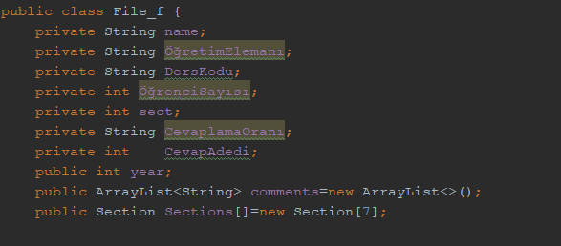
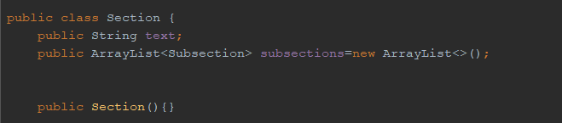
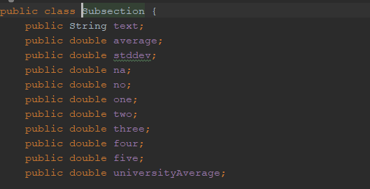
Reading Excel File:
To be able to read .xls type file in java we have to ,implement POI library
Firstly we write a proper classes such as File_F which composed of Section class and some parameters. And finally Section class composed of Subsection class.

Slide 2

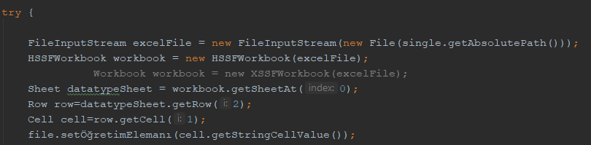
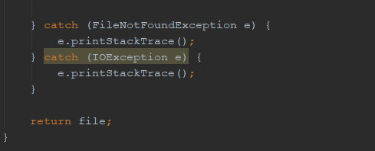
Analysing Single Excel File:
To analyse the given single file we write Method which takes as a parameter of File object. Then in the fucntion budy it opens that excel file, reads it ,later store the datas to the acquired objects. Finally returns a File_f object

Slide 3
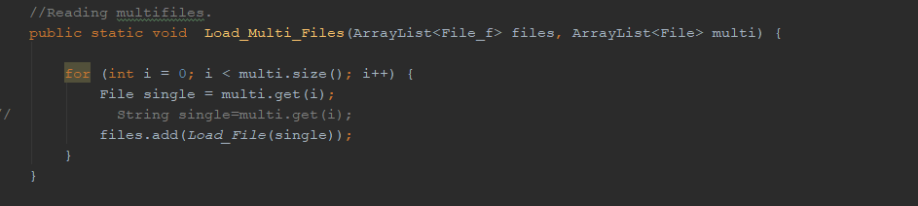
Analysing Multı File:
BY the help of the single file method we able to read multiple file.This method takes parameters such that File_f arraylist and File arraylists.It calls single file method until the lenght of the File list and while that procces it fills the Object arraylist

